Slide 1

Generative Models
Generating novel data, adversarial training
Yordan Darakchiev
Technical Trainer
iordan93@gmail.com

Slide 2
sli.do
#DeepLearning

Slide 3
Table of Contents
Generative models: basics
Unsupervised data generation
  Style transfer
  Generating sequences
  Variational autoencoders
Generative adversarial networks

Slide 4
Generative Models
Laying out the basics

Slide 5

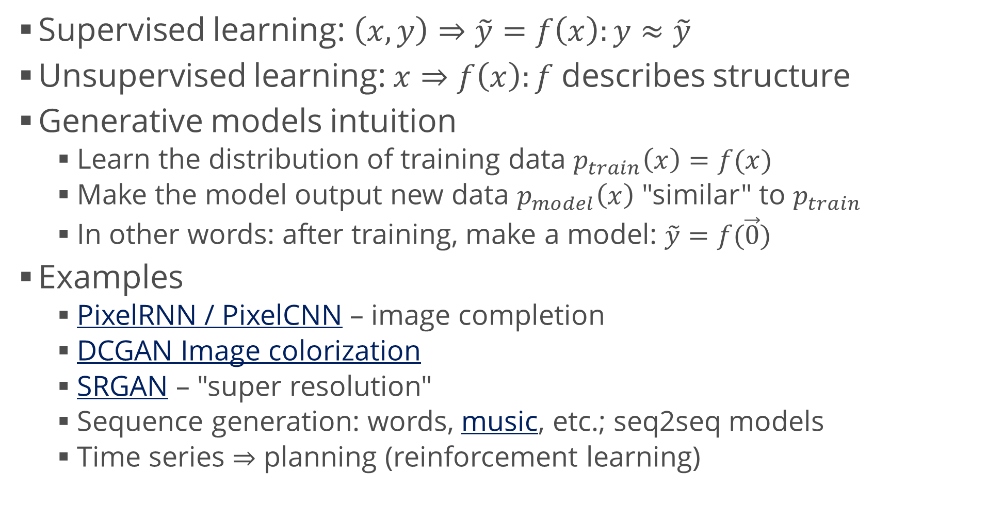
Generative Models Overview
Supervised learning: $\left(x,y\right)⇒\tilde{y}=f\left(x\right):y≈\tilde{y}$
Unsupervised learning: $x⇒f\left(x\right):f$ describes structure
Generative models intuition
  Learn the distribution of training data $p_{train}\left(x\right)=f(x)$
  Make the model output new data $p_{model}\left(x\right)$ "similar" to $p_{train}$
  In other words: after training, make a model: $\tilde{y}=f(\vec{0})$
Examples
  PixelRNN / PixelCNN – image completion
  DCGAN Image colorization
  SRGAN – "super resolution"
  Sequence generation: words, music, etc.; seq2seq models
  Time series $⇒$ planning (reinforcement learning)

Slide 6
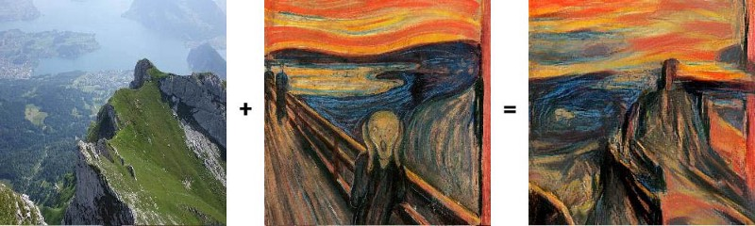
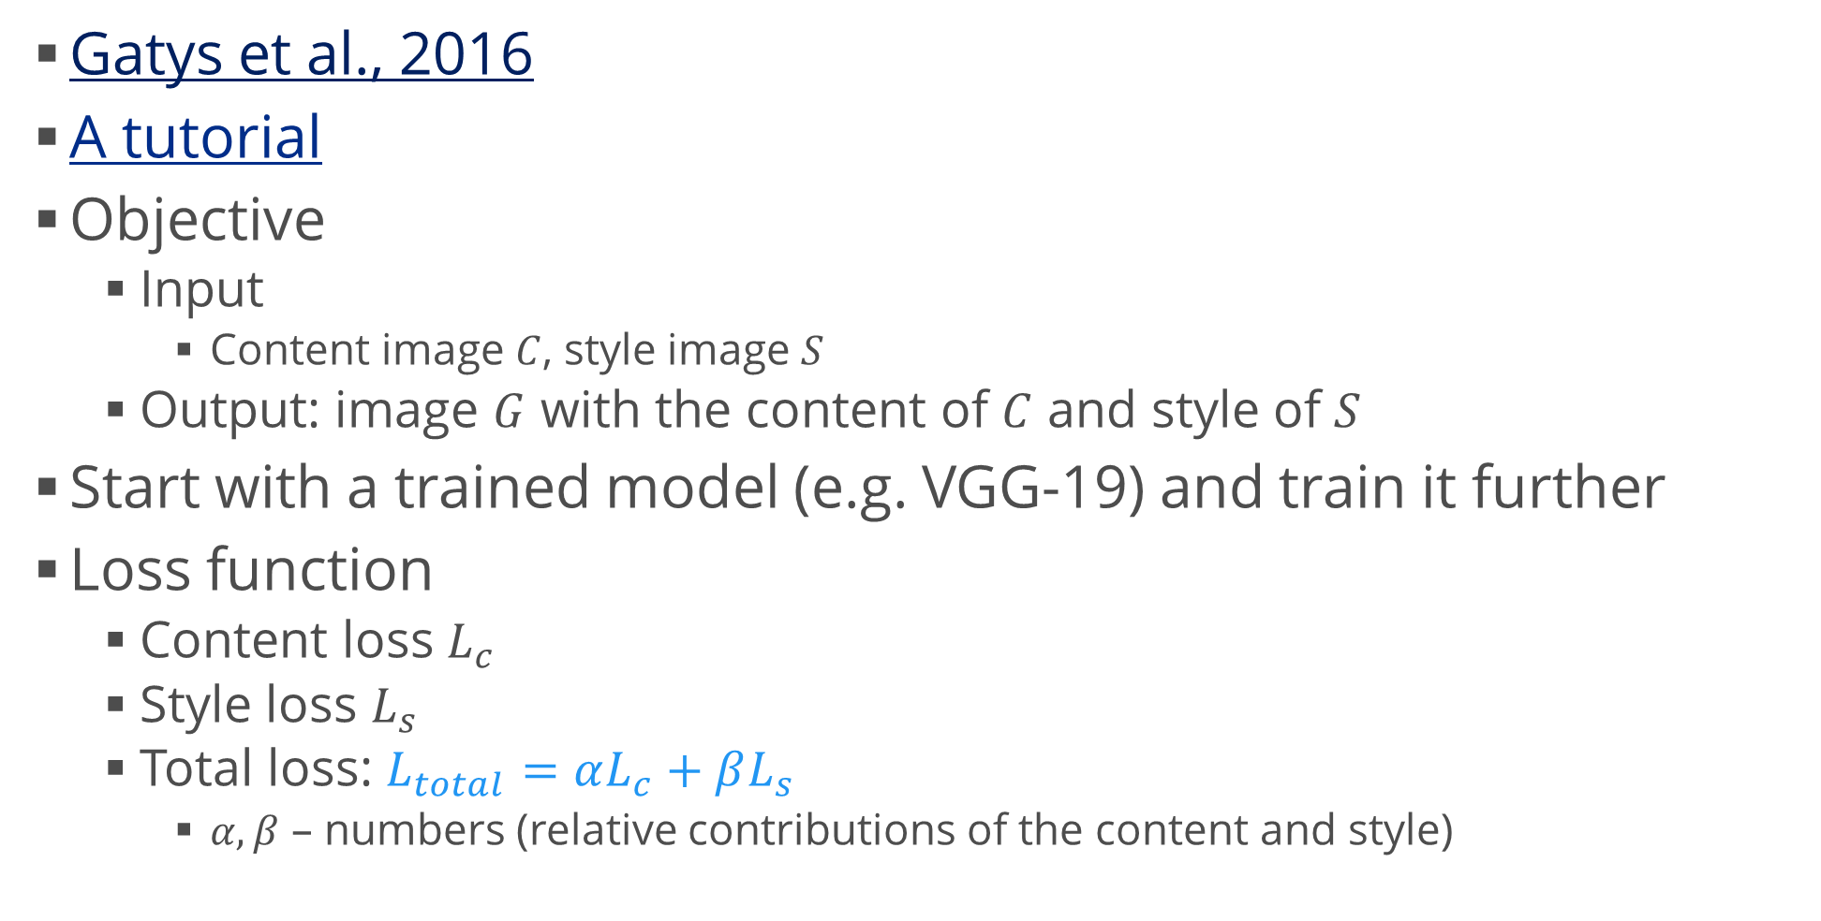
Style Transfer
Gatys et al., 2016
A tutorial
Objective
  Input
    Content image $C$, style image $S$
  Output: image $G$ with the content of $C$ and style of $S$
Start with a trained model (e.g. VGG-19) and train it further
Loss function
  Content loss $L_{c}$
  Style loss $L_{s}$
  Total loss: $L_{total}=αL_{c}+βL_{s}$
    $α, β$ – numbers (relative contributions of the content and style)

Slide 7
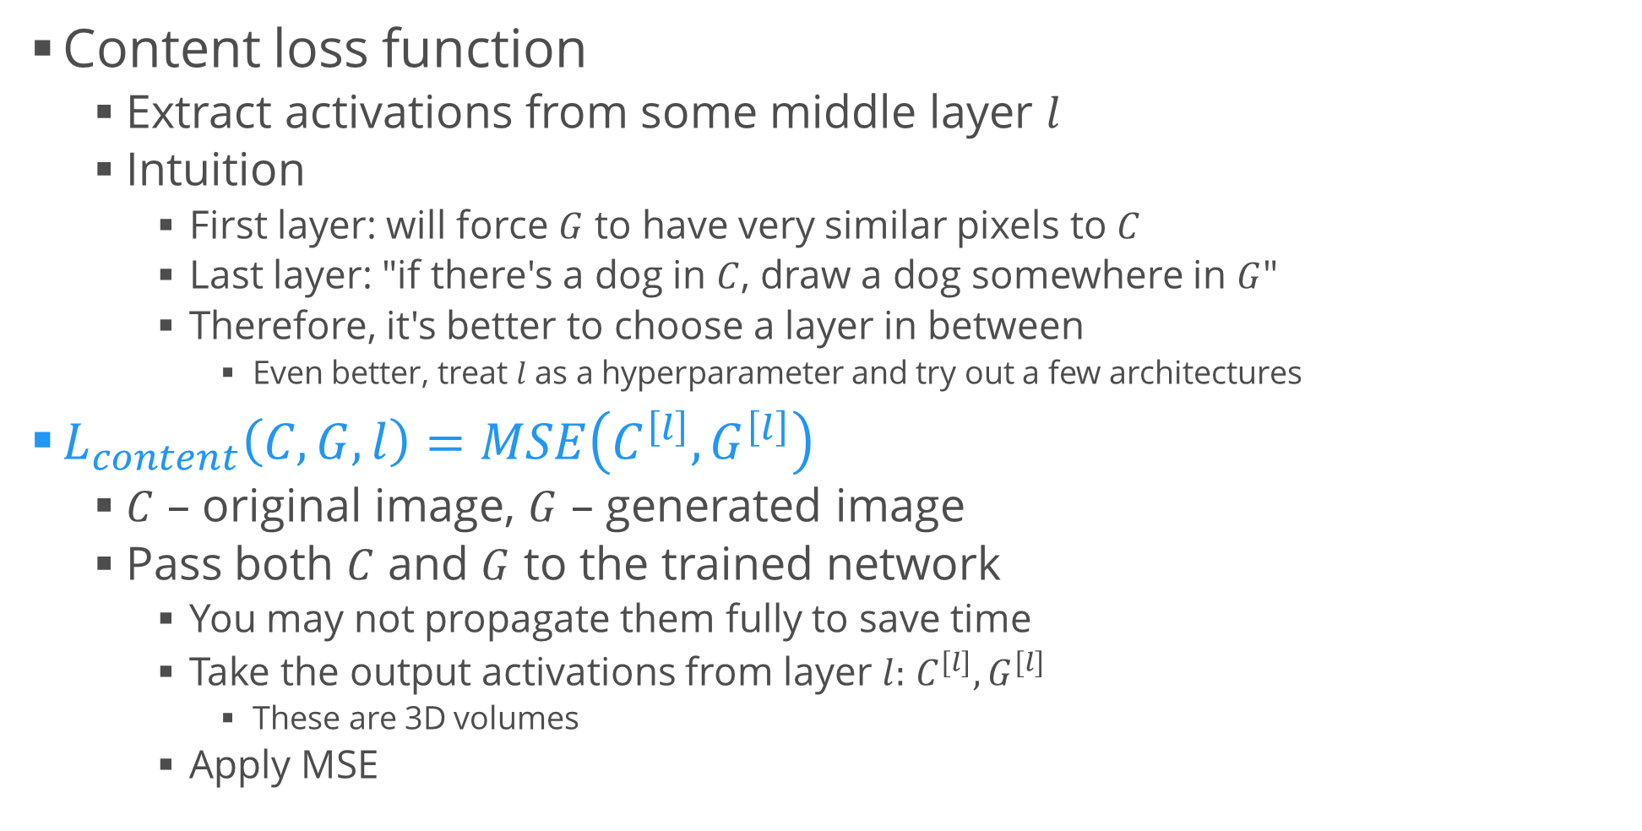
Style Transfer (2)
Content loss function
  Extract activations from some middle layer $l$
  Intuition
    First layer: will force $G$ to have very similar pixels to $C$
    Last layer: "if there's a dog in $C$, draw a dog somewhere in $G$"
    Therefore, it's better to choose a layer in between
      Even better, treat $l$ as a hyperparameter and try out a few architectures
$L_{content}\left(C,G,l\right)=MSE\left({C^{\left[l\right]},G}^{\left[l\right]}\right)$
  $C$ – original image, $G$ – generated image
  Pass both $C$ and $G$ to the trained network
    You may not propagate them fully to save time
    Take the output activations from layer $l:$ $C^{[l]}, G^{[l]}$
      These are 3D volumes
    Apply MSE

Slide 8
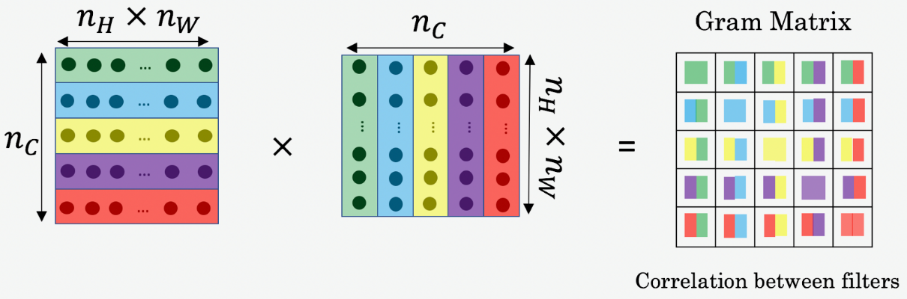
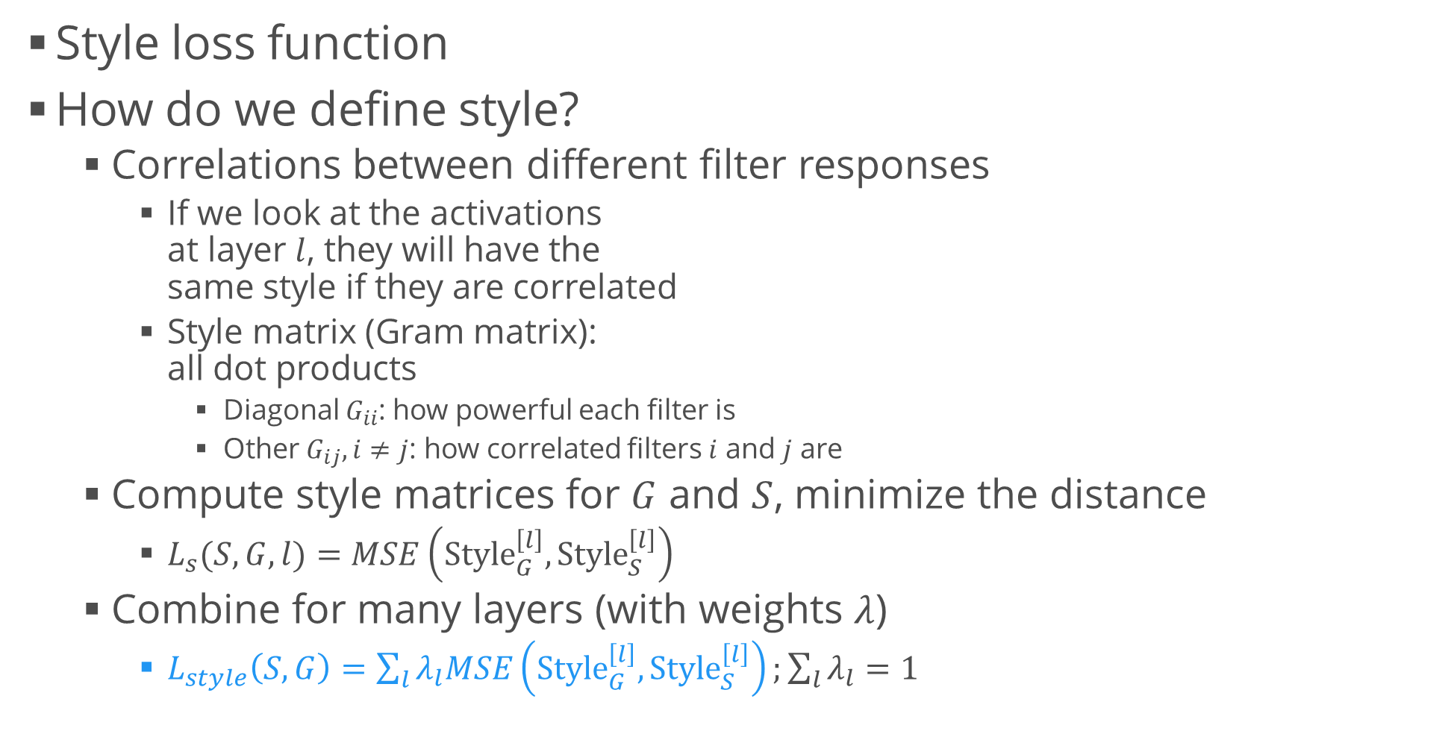
Style Transfer (3)
Style loss function
How do we define style?
  Correlations between different filter responses
    If we look at the activations
    at layer $l$, they will have the
    same style if they are correlated
    Style matrix (Gram matrix):
    all dot products
      Diagonal $G_{ii}$: how powerful each filter is
      Other $G_{ij}, i≠j$: how correlated filters $i$ and $j$ are
  Compute style matrices for $G$ and $S$, minimize the distance
    $L_{s}(S, G,l)=MSE\left({Style}_{G}^{\left[l\right]},Style_{S}^{\left[l\right]}\right)$
  Combine for many layers (with weights $λ$)
    $L_{style}\left(S, G\right)=\sum_{l}{λ_{l}MSE\left({Style}_{G}^{\left[l\right]},Style_{S}^{\left[l\right]}\right)};\sum_{l}{λ_{l}}=1$

Slide 9
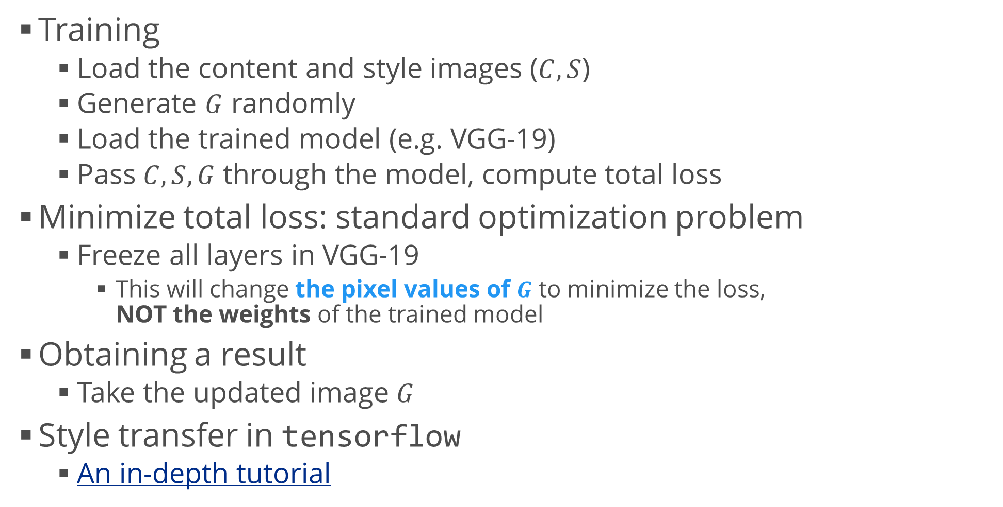
Style Transfer (4)
Training
  Load the content and style images ($C, S$)
  Generate $G$ randomly
  Load the trained model (e.g. VGG-19)
  Pass $C,S,G$ through the model, compute total loss
Minimize total loss: standard optimization problem
  Freeze all layers in VGG-19
    This will change the pixel values of $G$ to minimize the loss,
    NOT the weights of the trained model
Obtaining a result
  Take the updated image $G$
Style transfer in tensorflow
  An in-depth tutorial

Slide 10
Sequence Generators
Sampling novel sequences

Slide 11
Sequence Generation
We've already seen this
  Language modelling
  Music generation, more music generation (Magenta)
  Image completion (PixelRNN)
Training
  As usual, train a one-to-many RNN model
  Maximize the likelihood of input data (Bayes)
Generation
  Use a seed input (e.g. initial words, or a partial picture), predict next
    Continue until the end (e.g. [.] / <EOS> character or until the picture is done)
Drawback: generation can be slow
  Especially if we augment it by using beam search
  or a similar algorithm

Slide 12
Variational Autoencoders
Autoencoders with a simple trick

Slide 13
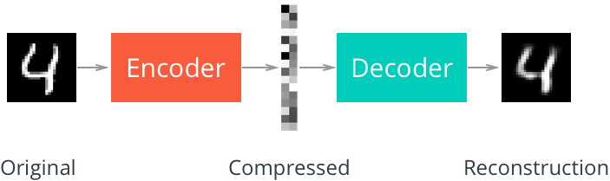
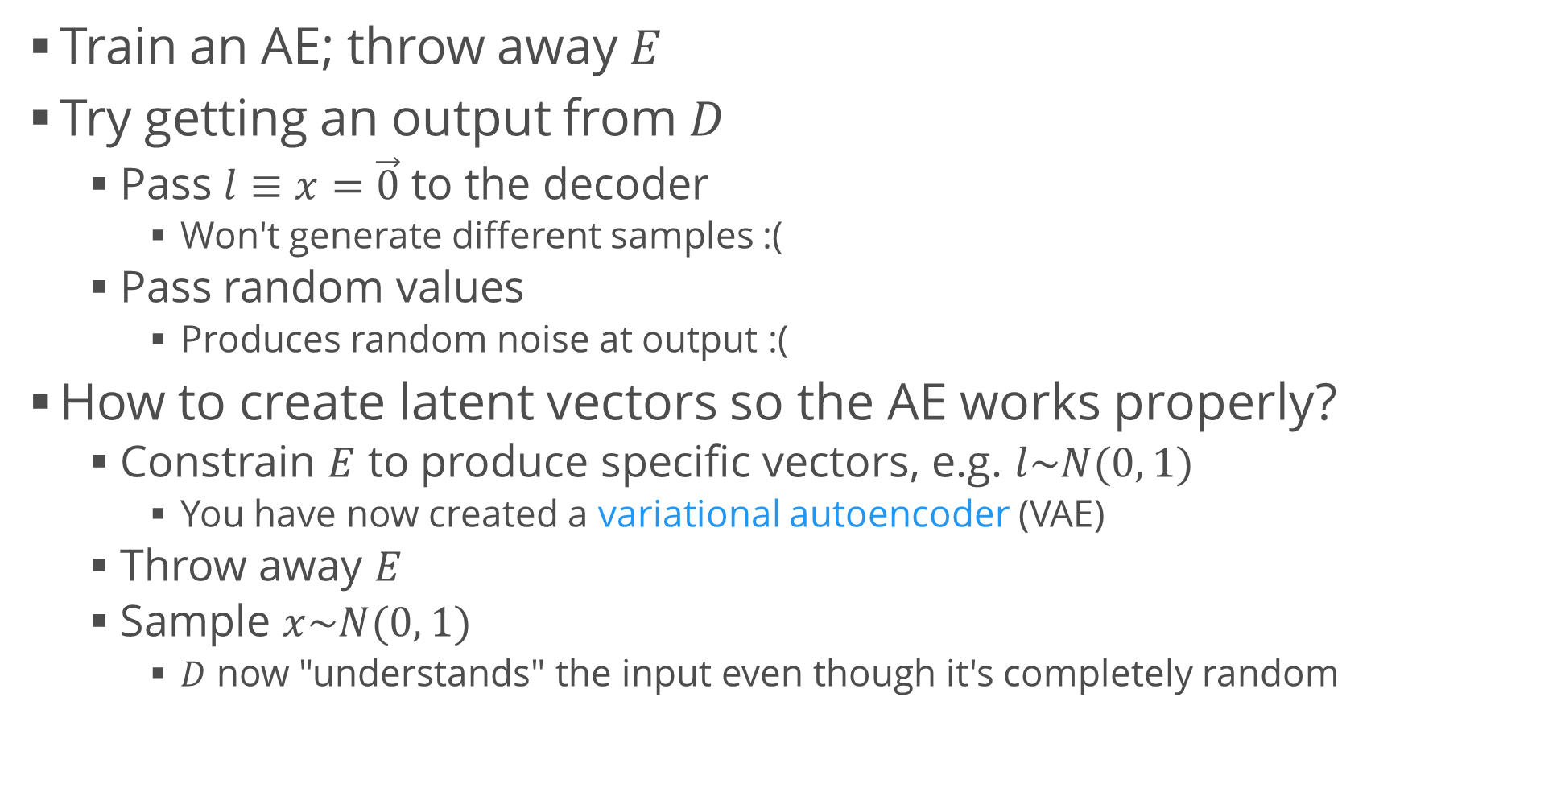
Variational Autoencoders
Train an AE; throw away $E$
Try getting an output from $D$
  Pass $l≡x=\vec{0}$ to the decoder
    Won't generate different samples :(
  Pass random values
    Produces random noise at output :(
How to create latent vectors so the AE works properly?
  Constrain $E$ to produce specific vectors, e.g. $l\sim N(0, 1)$
    You have now created a variational autoencoder (VAE)
  Throw away $E$
  Sample $x\sim N(0, 1)$
    $D$ now "understands" the input even though it's completely random

Slide 14
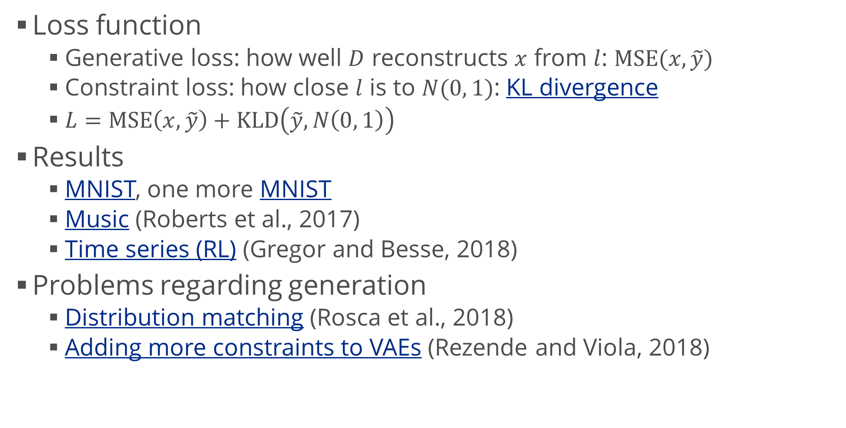
Variational Autoencoders (2)
Loss function
  Generative loss: how well $D$ reconstructs $x$ from $l$: $MSE(x, \tilde{y})$
  Constraint loss: how close $l$ is to $N(0, 1)$: KL divergence
  $L=MSE\left(x,\tilde{y}\right)+KLD\left(\tilde{y},N\left(0, 1\right)\right)$
Results
  MNIST, one more MNIST
  Music (Roberts et al., 2017)
  Time series (RL) (Gregor and Besse, 2018)
Problems regarding generation
  Distribution matching (Rosca et al., 2018)
  Adding more constraints to VAEs (Rezende and Viola, 2018)

Slide 15
Generative Adversarial Networks
Learning how to be the best

Slide 16
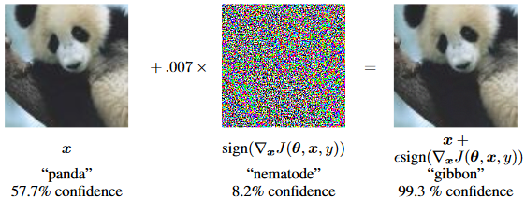
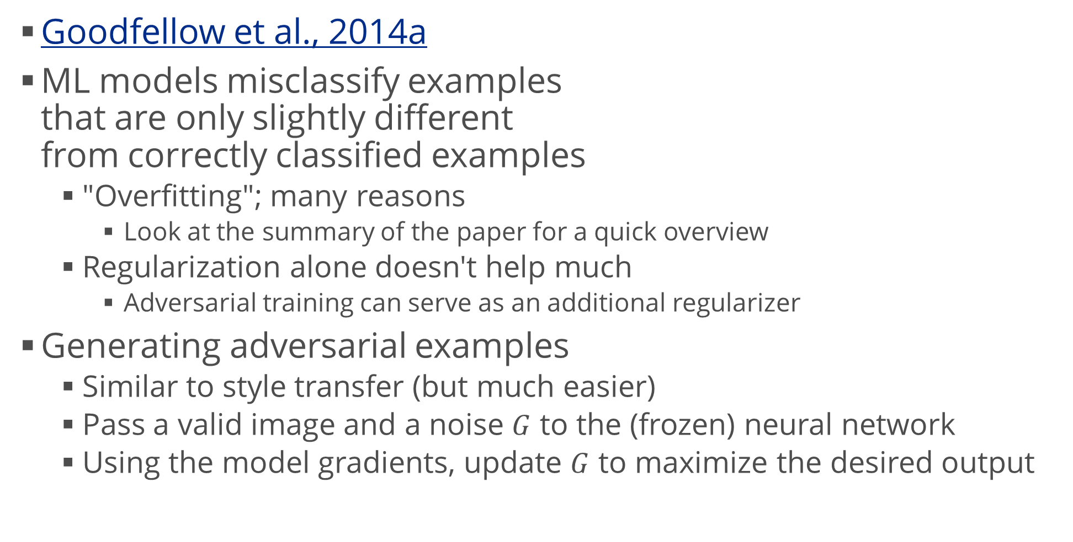
Adversarial Training
Goodfellow et al., 2014a
ML models misclassify examples
that are only slightly different
from correctly classified examples
  "Overfitting"; many reasons
    Look at the summary of the paper for a quick overview
  Regularization alone doesn't help much
    Adversarial training can serve as an additional regularizer
Generating adversarial examples
  Similar to style transfer (but much easier)
  Pass a valid image and a noise $G$ to the (frozen) neural network
  Using the model gradients, update $G$ to maximize the desired output

Slide 17
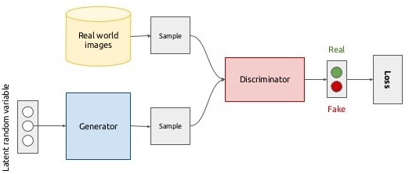
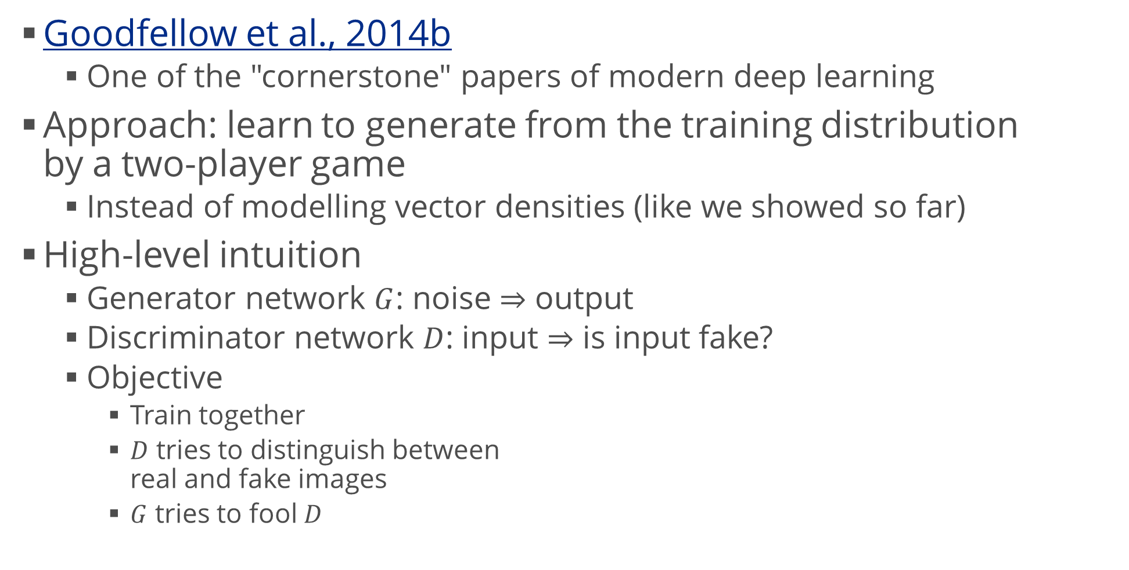
Generative Adversarial Networks
Goodfellow et al., 2014b
  One of the "cornerstone" papers of modern deep learning
Approach: learn to generate from the training distribution
by a two-player game
  Instead of modelling vector densities (like we showed so far)
High-level intuition
  Generator network $G$: noise $⇒$ output
  Discriminator network $D$: input $⇒$ is input fake?
  Objective
    Train together
    $D$ tries to distinguish between
    real and fake images
    $G$ tries to fool $D$

Slide 18
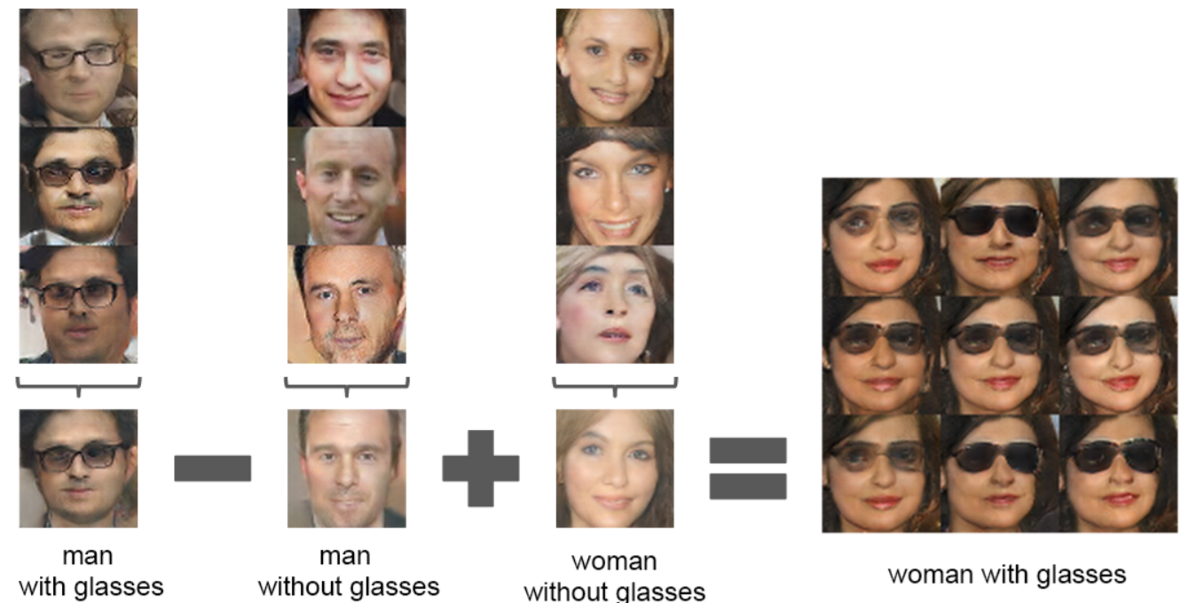
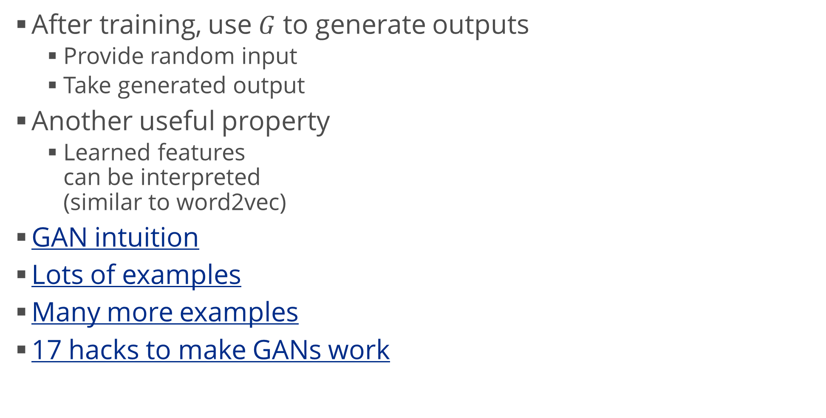
Generative Adversarial Networks (2)
After training, use $G$ to generate outputs
  Provide random input
  Take generated output
Another useful property
  Learned features
  can be interpreted
  (similar to word2vec)
GAN intuition
Lots of examples
Many more examples
17 hacks to make GANs work

Slide 19
Summary
Generative models: basics
Unsupervised data generation
  Style transfer
  Generating sequences
  Variational autoencoders
Generative adversarial networks

